Slide 1

UROP – Undergraduate Research Oriented Project
Pandemic Detection and Tracing Using
Blockchain and ML
Abhiram Thiriveedhi-AP20110010457
Bhargav Kumbham-AP2011001467
Vamsi Krishna Chakka-AP20110010442
Manish Chowdary Kalluri-AP20110010249

Slide 2
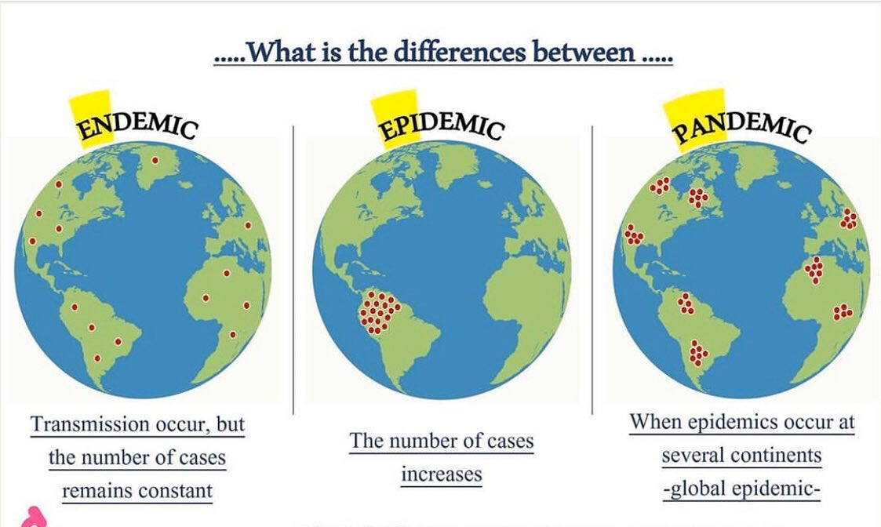
What is a Pandemic
A pandemic is a disease outbreak that spreads across countries or continents. It affects more people and takes more lives than an epidemic.
Ex: COVID-19,Spanish Flu etc
Pandemic vs Epidemic vs Endemic

Slide 3
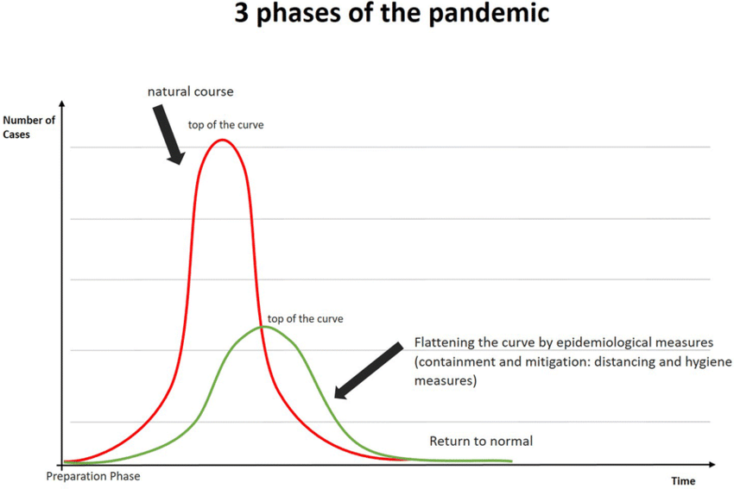
Phases of a Pandemic
The Centers for Disease Control and Prevention (CDC) currently has Pandemic Intervals Framework (PIF) in place for tracking the phases of an influenza pandemic. That framework is being applied to COVID-19.
Phase 1: Investigation Interval
Phase 2: Recognition Interval
Phase 3: Initiation Interval
Phase 4: Acceleration Interval
Phase 5: Deceleration Interval
Phase 6: Preparation Interval

Slide 4
Ways to mitigate the pandemic
Social Distancing through Lockdown, Containment zones
Maintaining personal hygiene along with keeping our surroundings clean
Using masks to avoid the transmission of virus
But the most important among all the ways is TRACING TESTING TREATEMENT (3T’S)
Tracing the contacts of the infected persons and testing them slows down the spread of the pandemic by a huge rate.

Slide 5
How countries made use of technology in contact tracing
South Korea – tracking using GPS
Germany – smartwatch data to detect illness
India – Aarogya Setu
Singapore – usage of temperature data from thermometers to identify clusters and hotspots

Slide 6
Drawbacks
Breach of Privacy
Data security
Expensive
Chance of error
Not of much use if the infected person doesn’t use a mobile phone
Requires trained people

Slide 7
Getting ready for the next pandemic
Digitalizing the medical records of patients all over the globe i.e implementing EHR(electronic health records) and EMR(electronic medical records)
Strong and resilient health systems, in particular primary care, to facilitate detection of disease outbreaks
Tracking the pandemic using ML algorithms and alerting the respective countries based on the results
Need for well-functioning supply-chains as well as adequate stockpiles of essential goods and equipment.
Using AI and big data for predictive modeling

Slide 8
Using ML to combat the pandemic
One common approach to pandemic detection using ML is to analyze data from sources such as hospital records and disease surveillance systems. This data can provide insights into the spread of a disease and its potential impact on the population.
Also tracking of pandemic can be implemented from real-time location of people and thereby identifying the clusters and hotspots
By using several ML anddata mining techniques contact tracing can be made a lot easier
The use of ML in pandemic detection is a promising approach that can help to quickly identify and respond to potential outbreaks, protecting public health and saving lives.

Slide 9
Usage of blockchain in mitigating the pandemic
To get the trust of users to share data ,one potential solution is the use of blockchain technology, which can provide a decentralized and secure platform for storing and sharing information related to pandemic detection.
Blockchain allows for the creation of a distributed database that can be accessed and updated by multiple organizations and individuals. This can facilitate the sharing of information such as medical records, test results, and travel histories, which can be used to identify patterns and predict the likelihood of an individual being infected with a disease.
In addition, blockchain's decentralized nature ensures that this information is secure and cannot be easily altered or compromised

Slide 10
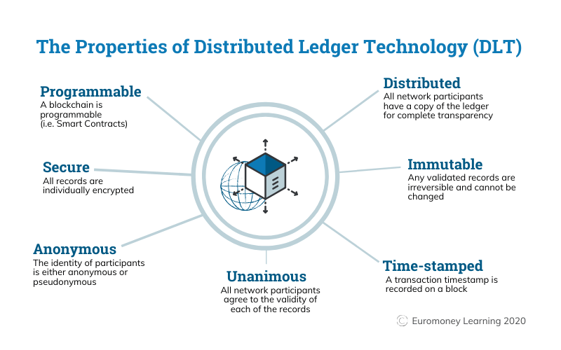

Slide 11
Basic Idea of the project
The idea of this project is to digitalize all the patients health records and using ML to predict the diseases.
If we are able to predict the disease and take the necessary measures, then it is possible to slow down the pandemic at an early stage
To create a sense of trust among people to give their medical data, block chain technology can be used
Through this data transparency, security and trust among people can be achieved
One more advantage by using this is decentralization, where every hospital can access the EHR of the patient. This makes the countries to decide which country population they could allow and take precautionary measures
Project is implemented in two phases
a)Detecting disease from X-rays using CNN (we took COVID-19 as example)
b)Integrating the medical data onto the blockchain

Slide 12
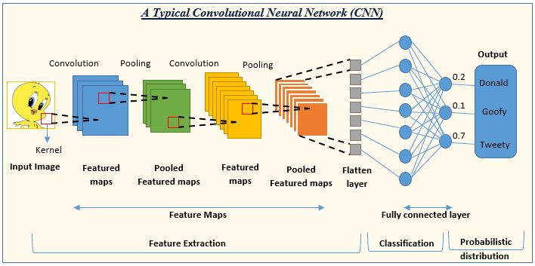
Convolution Neural Network
A convolutional neural network (CNN) is a type of artificial neural network (ANN) that is designed to recognize patterns in images.
The most important layers in a CNN are the convolutional layers, which use a mathematical operation called convolution to detect patterns in the input data. These patterns are then passed on to the next layer in the network, where they are combined and processed further until the final output is produced. CNNs are often used for tasks such as image classification, object detection, and image segmentation.

Slide 13
Steps to construct a CNN model for a X-ray dataset
1-Import the required libraries
2-Acquire a dataset of X-ray images that are labeled with the correct categories (COVID and Normal). This dataset will be used to train the CNN.
3-Pre-process the data set to prepare it for input to the CNN. This may include resizing the images to a standard size, normalizing the pixel values, and applying data augmentation techniques to increase the size of the dataset.
4- Assign the values 0 for COVID-19 and 1 for Normal
5- Define the model
6-Add convolution, pooling and fully connected layers
7-Add output layer
8-Compile the model
9-Fitting the model i.e train the CNN using training and validation datasets
10-Evaluate the model
11- Use the trained CNN to process X-ray images and make predictions about their categories.

Slide 14
After constructing the CNN, a chest x-ray dataset containing both covid and normal images were taken (0 for covid and 1 for normal). The prediction model was used to classify the x-ray
For COVID-19 X-ray
The image was resized and converted into an array for finding the patterns

Slide 16
For Normal X-rays
The image was resized and converted into an array for finding the patterns

Slide 17
Deployment of Patient’s data into the Ethereum blockchain
We import the patient’s data including the result whether he/she has COVID-19 or not and store this data into the Ethereum blockchain by creating a smart contract in solidity programming.
A smart contract is a self-executing contract with the terms of the agreement between buyer and seller being directly written into lines of code. The code and the agreements contained therein exist across a distributed, decentralized blockchain network.
Smart contracts are typically implemented using a blockchain platform such as Ethereum.
To create a smart contract, we use solidity an object-oriented programming language.
Along with this , access to enter data into the blockchain will be restricted to administrators only.

Slide 18
Future work
Developing more advanced machine learning algorithms that can be used to analyze large amounts of data in real time, and identify patterns and trends that may indicate the presence of a pandemic. This could include the use of techniques such as deep learning and natural language processing, which have proven to be effective in other areas of data analysis.
Exploring the potential for using blockchain technology to track and monitor the spread of infectious diseases. This could involve the creation of decentralized networks that allow for the secure and transparent sharing of data between different organizations and individuals, enabling more effective tracking and response to pandemics.
Overall, it is likely that the use of machine learning and blockchain technology in the field of pandemic detection will continue to evolve and improve in the coming years, as researchers and developers continue to explore new ways to harness these technologies to better protect public health.

Slide 19
Thank you

